Slide 1
THE EFFECT OF HEAT TREATMENT ON THE PROPERTIES OF ZIRCONIUM - CARBON STEEL BIMETAL PRODUCED BY EXPLOSION WELDING
xplomet
Mariusz Prażmowski ¹⁾, Henryk Paul ²⁾, Fabian Żok ^{1,3)}
¹⁾ Technical University of Opole, Mechanical Department,
²⁾ Institute of Metallurgy and Materials Science PAN,
³⁾ ZTW Explomet,
Notes:
Ladies and Gentlemen. My name is Fabian Żok and I will try to present to you the part of the research, which was carried out under the frame of the project funded by the National Center for Science.
The research included an analysis of the Impact of the heat treatment on the properties and structure of the bimetal zirconium and carbon steel made by ​​explosive welding technology.
Co-authors of the work are Professor Henry Paul from the Institute of Metallurgy and Materials Science in Krakow, and Dr Mariusz Prażmowski from the Technical University of Opole

Slide 2
Presentation plan
Aim of the study
Research material
Characteristics of the received bonds
Heat treatment parameters
Mechanical properties of the claddings
Changes of hardness profile in the bonding zone
Analysis of the microstructure
Summation
Notes:
In the frame of the presented topic, I would like to briefly introduce you in the scope of the presented work, the results of the mechanical and structural tests, and finally the conclusions of the conducted observations and analysis.

Slide 3
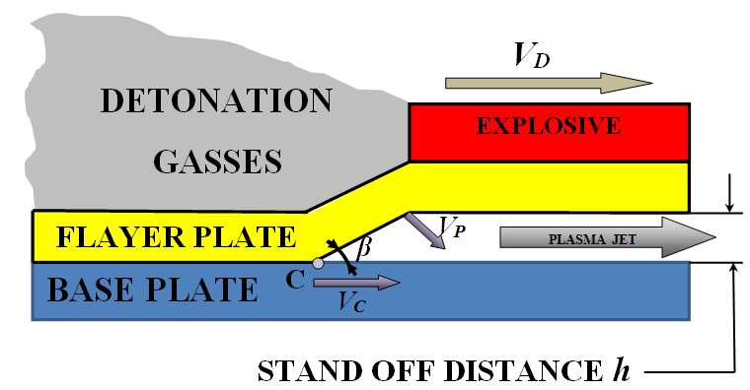
Explosive cladding
Fig. Schematic of the parallel explosive cladding. v_{D} – detonation velocity, h – initial distance betwen plates, v_{P} – plates collison velocity, v_{c} – collison velocity at point C. C – collision point, β – collision angle.
Notes:
Technological aspects of the explosive bonding are probably familiar to most of those present here, so I will not here go into the details. At this point I would just remind you that a permanent connection with the required mechanical properties are obtained as a result of collisions with sufficient speed, the applied clad plate on the basic. The cladding plate reaches the required acceleration as a result of the detonation of explosives on its ( the products of detonation of the explosive).
Energy collision, among others, determined by the initial distance between the engaging plates and detonation velocity (energy explosion). Unfortunately, the process of collision creates additional technological problems arising from the increase in stress and a strong deformation hardening of materials in the connection zone. This phenomenon causes a significant increase in the areas immediately adjacent the strengthening of the boundary connection. In addition, exceedance of the process, particularly detonation velocity, promotes the formation of brittle and hard layers which are melted in the bonding zone, which tend to crack.

Slide 4
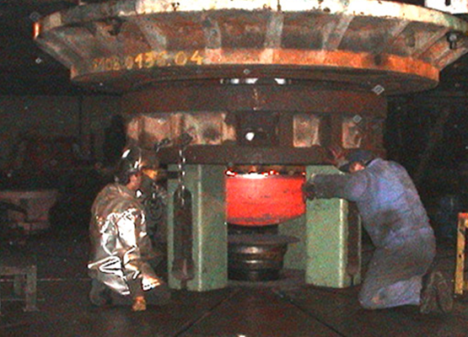

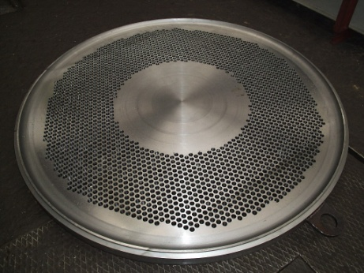
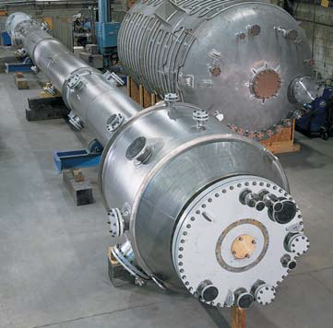
Cladding processing operations
Straightening
Forming
Drilling
Welding
Notes:
The tensions and the strengthening of the bond zone significantly affect to the further processing of explosively welded materials, which includes: straightening, bending, welding, etc. In this case, an important issue in the production of cladding materials is the heat treatment.
The most important issue in the subject of heat treatment of the cladded materials, often with very different properties, is the selection of process parameters. It is conditioned mainly by the chemical composition of the bonded materials and dimensions of the elements, due to the possibility of its deformation during heating and cooling.

Slide 5
Aim of the study
The aim of the study is to analyze the effect of heat treatment for changes of mechanical properties and structural strengthening bimetals zirconium alloy steel bonded by explosive welding method.

Slide 6
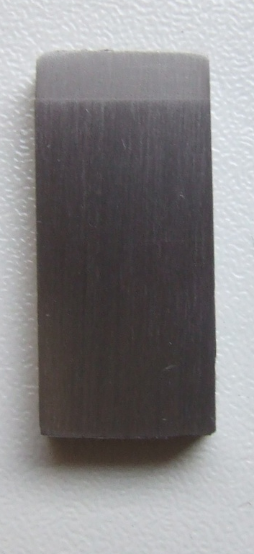
Research material
Zr 700 (gr.3,175 mm)
Material | The chemical composition[%]
 | C | Fe, Cr | H | O | Zr+Hf | N
Zr 700 | < 0,002 | 0,05 | < 0,0003 | 0,05 | >99,2 | < 0,002
Tensile strength [MPa] | Yield strength [MPa] | Elongation [%]
R_{m} | R_{0,2} | A
280 | 143 | 35
Material | The chemical composition [%]
 | C | Mn | Si | P | S | Ni | Cr | Mo | Al | N | Nb
P355LN2 | 0,170 | 1,13 | 0,345 | 0,008 | 0,001 | 0,285 | 0,150 | 0,035 | 0,045 | 0,004 | 0,019
Tensile strength [MPa | Yield strength [MPa] | Elongation [%]
R_{m} | R_{0,2} | A
551 | 402 | 26,7
P355NL2 (gr. 20 mm)
Notes:
Subject of test were bimetallic systems made by ​​explosive welding technology where the base material is a carbon steel plate in P355NL2 grade and 20 mm thickness. Clad material is a zirconium plate in grade Zr 700 in thickness of 3.175 mm. In tables on the slide shows the chemical composition and mechanical properties of both materials. The ​​shown values are based on manufacturer's certificate.

Slide 7
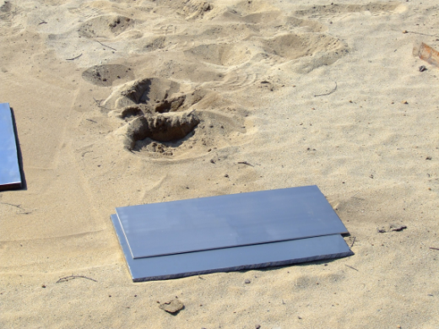
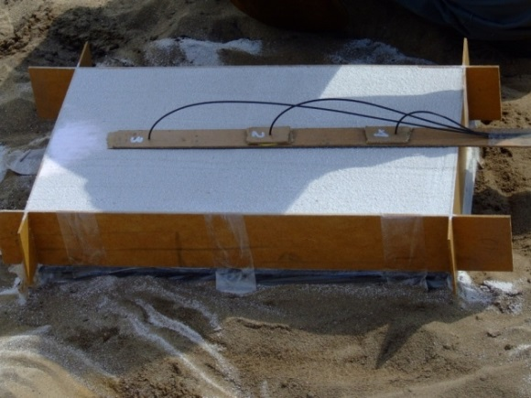
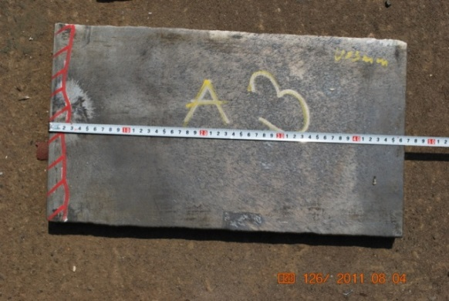
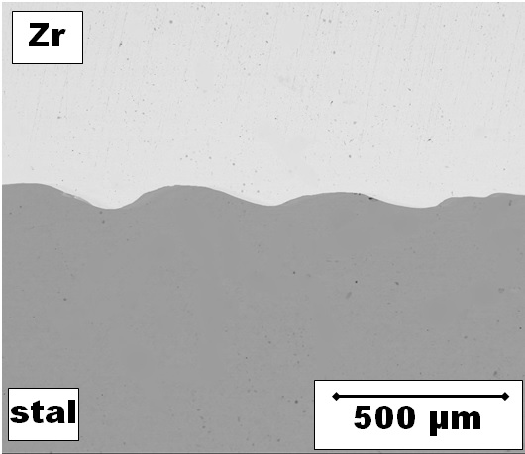
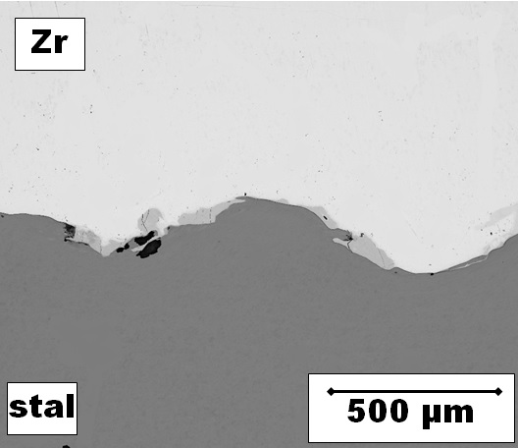
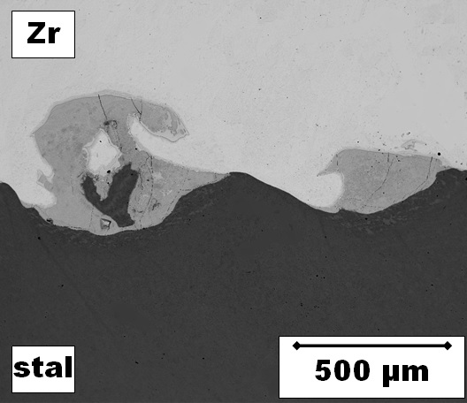
Research material
 | Zr 700 + P355NL2 (3,175 mm)+ (20 mm)
Deotantion velocity V_{D} [m/s] | V_{D} | 1,3 V_{D} | 1,6 V_{D}
Deotantion velocity V_{D} [m/s] | 2200 | 2800 | 3500
Distance between plates h [mm] | const
steel
steel
steel
Notes:
The welding process was performed with an initial constant distance between the plates equal to 6 mm and variable detonation velocity with values ​​that are shown in the table. In further part of the presentation adopted marking of plates and samples, as: Vd, 1.3 and 1.6 vD.
The use of such different detonation velocities let to obtain research’s material with different characteristics of bond zone, particularly with participation of the melting layer which can be seen on the presented pictures.
In all three cases obtained bonds with wavy characteristic. The smallest detonation velocity favored the creation of bond practically without the melted layer. Increasing the velocity of detonation caused an increase of share of brittle intermetallic layer in the joint.

Slide 8
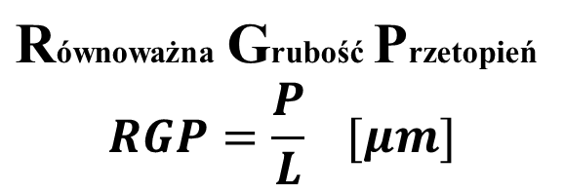
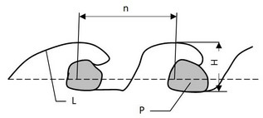
The interface parameters for different V_{D}
V [m/s] | Bond length L [μm] | Average wave heigh H [μm] | Average wave length n [μm] | Summary area of meltins P [μm²] | The equivalent thickness of meltings RGP [μm]
V_{D} | 12 685 | 58 | 454 | 5 596 | 0,46
1,3 V_{D} | 13 648 | 148 | 1002 | 137 484 | 10.06
1,6 V_{D} | 16 823 | 214 | 940 | 912 943 | 54,30
Melt depth equivalent
where: P – summary area of meltings, [ µm²]
L – bondline length [ µm]
n – wave length [ µm]
H – wave heigh [ µm]
Notes:
Based on analysis with the use of scanning microscope and image analysis determined a detailed description of the bond zone for the three cases.
The measurements of the base parameters of the border of bond zone including its height and length of wave. Defined also of ​​the meltings occurring in the bond zone.
Measurements were made on the length of the bond line not less than 10 000 micrometers. The table shows the average values ​​for the particular systems . Basis on the obtained results with use of the formula for an equivalent thickness of meltings RGP, defined share of melting layer in joint.
Analysis of the results shows that the Vd sample can be qualified to group of bonds without meltings. Sample 1.3VD can be considered as the sample with maximum, acceptable shear of melting layer in the joint, and the sample 1.6 VD as the sample with unacceptable shear of melting layer in the joint. The graph shows the changes of parameters of bond, depending on the growth of velocity of detonation .

Slide 9
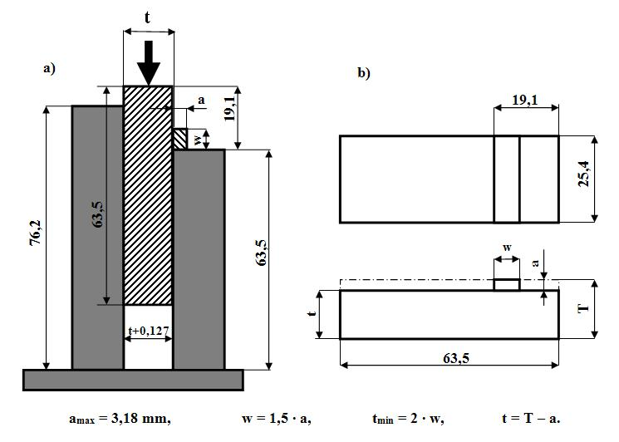
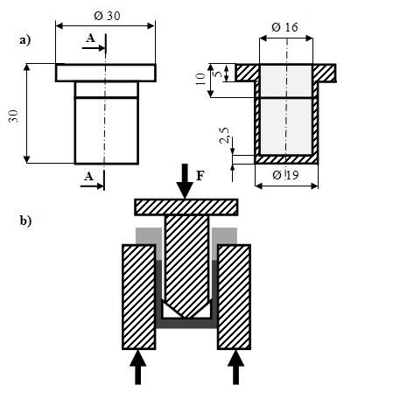
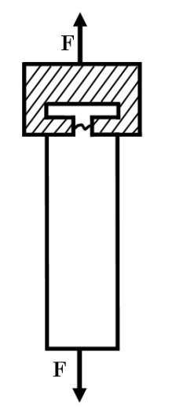
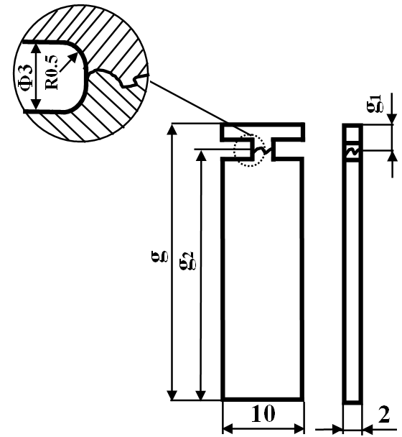
Mechanical properties
Fig. Peel off specimen -R_{O}
 |  |  | Clad + base material
 |  |  | Zr 700+ P355NL2 (3,175 mm)+ (20 mm)
Plate |  |  | V_{D} | 1,3 V_{D} | 1,6 V_{D}
Shear strength R_{s} |  | MPa | 351 | 321 | 281
 |  | Place | Zr | Zr | złącze
Peel off strength R_{o} |  | MPa | 449 | 144 | 180
 |  | Place | Zr | złącze | złącze
Tensile strength R_{m} |  | MPa | 544 | 563 | 184
Rys. Shear test specimen - R_{S}
Tab. Mechanical properties of claddings after joinig
Rys. Tensile test specimen R_{m}
Notes:
For the analyzed systems were performed mechanical property tests, required for explosive cladding materials such as shear and ram test and additionally tensile test. Tests carried out on the samples and according to the schemes shown on the following drawings. The table shows average values, obtained for each system, together with indication of the place where occur destruction of the sample.

Slide 10
The selection of heat treatment parameters
Fig. Microhardness of bimetal for variable heat treatment temperature
Notes:
The next step of research was to conduct heat treatment of analyzed bimetallic systems and determination of its effect on mechanical properties. Selection of heat treatment parameters for cladding materials is not simple, because we have two different materials with different properties. Its selection, notably is based on trials carried out in a wider range of temperature and determination of material properties for each of these temperatures.
In the frame of realized work, performed heat treatments over the samples in the range of temperature, from 400 to 700 degrees Celsius, which was increasing by every 50 degrees. Holding time was 60 minutes. The material in the condition after cladding and after heat treatment was controlled for micro-hardness in the bond zone in order to determine changes of strengthening in this area. The largest changes were observed in the distances about 0.5 mm from the border of joint. Average results are shown on the graph. Red continuous line indicates the optimal temperature of 600 degrees, at which the steel and zirconium show a steady decreasing of strengthening.

Slide 11
The selection of heat treatment parameters
Fig. Tensile strength Rm of the bimetal for a variable heat treatment temperature
Notes:
For the analyzed cases of stress-relief annealing at various temperatures, was performed tensile tests, from which average results are reported on the slide. Basis of the graph analysis, it can be concluded that the optimum processing temperature is in the range between 550-600 degrees Celsius. In this range, a decrease in strength compared to the strength of the output cladding element was 20%.

Slide 12
The selection of heat treatment parameters
Stage I
Heating wit the furnace until 300⁰C within 35 min.
Stage II
Heating up to 600⁰C with velocity 100⁰C/h.
Stage III
Annealing in 600⁰C over 90 min.
Stage IV
Cooling until 300⁰C with a velocity 100⁰C/h.
Stage V
Cooling in still air.
Fig. Course of the heat treatment
Notes:
Basis on the performed analysis of the results of tests, adopted parameters and heat treatment stages as illustrated on following slide. Stage I ......

Slide 13
Testing of mechanical properties
30-35%
15 %
10%
30%
Fig. Mechanical properties (strength: shear- R_{s}, peel off- R_{o}, tensile- R_{m}) off caldding metal after joining (solid line) and after heat treatment (dotted line)
Notes:
For all the analyzed systems after stress-relief annealing were performed mechanical property tests, the same as for materials in condition after cladding only. The results of obtained mechanical tests opposed with results obtained on bimetal before heat treatment and shown in the graph. The dotted line on the graph runs mechanical property changes of the samples are comparable to heat treated samples with the course prior to treatment.
Basis on the analysis of the obtained results it can be concluded that the heat treatment process has a significant impact on tensile strength and ram strength but slight for shear strength. Considering tensile strength (Rm) heat treatment caused reduction for ca. 30% of strength for the samples with the smallest (0.5μm) and the maximum acceptable (10um) share of melted layer.
For sample 1.6vD tensile strength (Rm) after heat treatment was reduced for 10%, in relation to the sample in initial condition. The opposite trend was observed at ram test (Ro). The strength of the sample, where melted areas occurred in the bond zone (1.3vD, 1.6vD) decreased for ca. 30%. For the sample without meltings reduction was 15% in relation to the bimetal before heat treatment. Considering shear test (Rs) were observed a small reduction of strength for approximately 10%. In all analyzed cases, the samples after heat treatment were destroyed in the joint.
In all performed tests side bend specimens were bent through an angle of 180 °, and there were no cracks or delamination.

Slide 14
Strengthtening in bond zone - (microhardness HV0,05 )
35%
Fig. Microhardness distribution in bond zone for different detonation velocities:
a) 1.0v_{D}, b) 1.3v_{D}, c) 1.6v_{D},
solid line- materiał w after „cladding”, dotted line – after heat treatment
35-45%
45%
50%
35-45%
35-45%
Notes:
The analysis of changes of strengthening was performed basis on the systematic measurements of micro-hardness with a load of 50G. Measurement was made for materials in the initial condition and after heat treatment on the entire cross-section of the cladding element and in the most strengthened bond zone, it means up to 0.5 mm from the border of bond.
Analyzing changes in the steel strengthening as a result of the heat treatment carried out, it can be concluded that the greatest decline in hardness was observed directly on the border merger. In all analyzed cases, the results show the hardness measurements at a level close to the hardness of the steel before welding (about 175 HV0.05).
For sample 1.0vD 35% decrease was observed in hardness relative to the hardness upon bonding (Fig. 7a), while at a speed of 1.3vD decrease of hardness approached 45% (Fig. 7b). The biggest 'softening' of the material was approximately 20μm from the edge of the bi-metal connections made ​​at the highest velocity of detonation (1.6vD), by as much as 50% compared to the hardness, the same distance, the state of the symphysis (Fig. 7c) . Softened zone size in the base material corresponds to the values ​​in strengthening plates and output samples 1.0vD and 1.3vD is 80μm and 140μm respectively. The further away the strengthening stabilizes and is about 10% smaller than the strengthening of the state immediately after welding.
For sample 1.6vD heat treated hardness stabilization was observed at the level of 230 to 140 HV0.05 within Pm. In the case of zirconium was softening (hardness reduction) by about 35-45% compared to the state after bonding, practically throughout the analyzed area (up to 0.5mm from the edge of the connection). Hardness distribution over the entire cross cladded plate was similar for all cases analyzed and fluctuated in the range of 140-150 HV0.05.
For a disc at the maximum velocity of detonation (1.6vD) obtained at the level of hardness 346HV0.05 and is approximately 16% higher than the hardness of a disc recorded at a speed 1.3vD (Fig. 7d). In the case of a detonation velocity 1.0vD microhardness reached 265HV0.05 (Fig. 7a and d), which showed a decrease by a further 13%.
In the case of the material applied (Zr) in the immediate vicinity of the connection boundary hardness was approximately 230 HV0.05 irrespective of the velocity of detonation (Figure 7d). With increasing distance from the border of strengthening the connection drops and the case without a layer of melting (1.0vD) stabilizes at a distance of approximately 80μm and for 1.3vD within 140μm. For the largest share of meltings (velocity of detonation 1.6vD) has not reached a stable level over the measurement area (Fig. 7c, d).

Slide 15
Strengthening in bond zone - (microhardness HV0,05 )
170 HV
140 HV
Fig. Microhardness distribution in bond zone for different detonation velocities – summary graph. Measuring along 3 parallel lines trough the bond line (perpendicular to the bond). Applied load: 50G.
Notes:
It is worth to pay the attention to the fact that, irrespective of the parameters of explosive welding process, after heat treatment hardness in the closest area to the border of bond about 20 microns for all cases is similar. This phenomenon occurs both in the base and the clad material. At these points were recorded value of 170 HV for steel and 140 HV for zirconium.

Slide 16
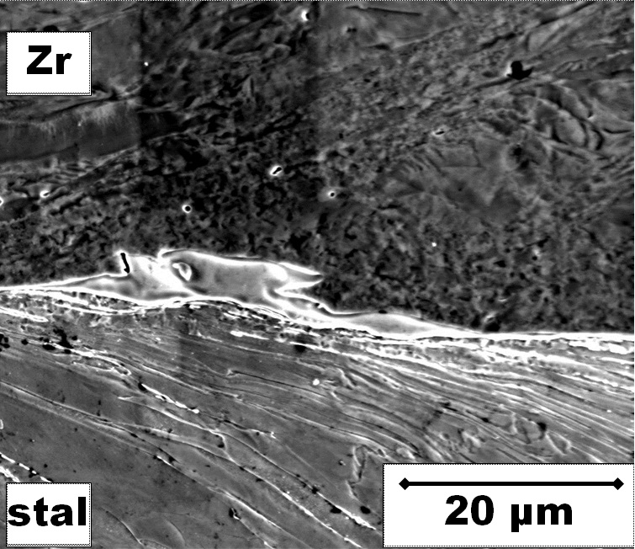
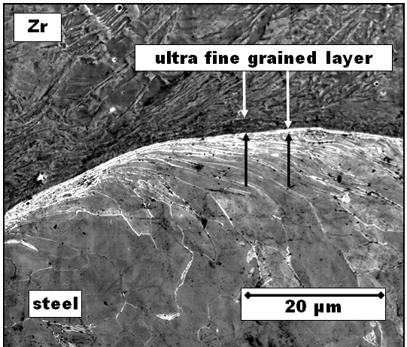
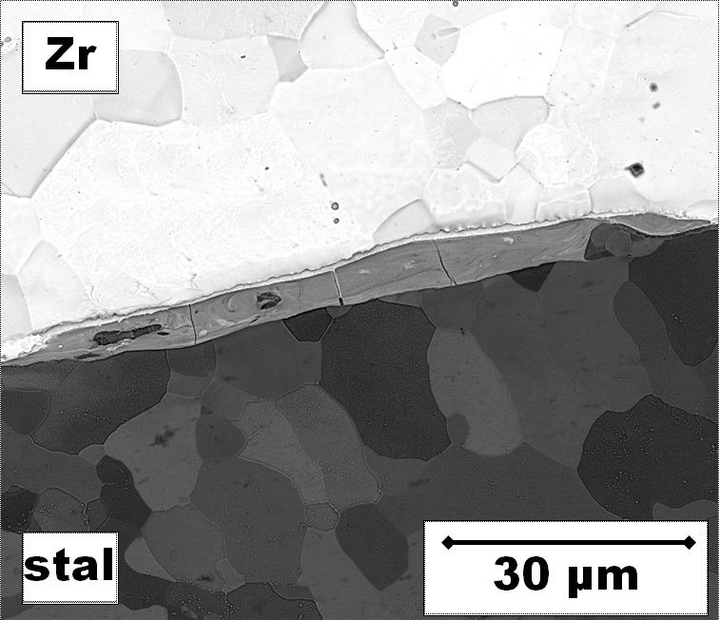
Microstructular analysis
a
b
steel
c
Fig. Microstructure of bonding zone of Zr700/P355NL2 bimetal, showing strong deformation of subsurfaces of combined plates: a) wave bottom, b) wave edge, c) structure of bimetal after heat treatment.
steel
Notes:
Structural observations of the joint area in materials in the initial condition showed a strong deformation in the direction of the detonation front. Strongly deformed structure is particularly clearly marked in the area of steel, where was observed an elongated ferrite grains. Additionally, in the area closest to the border of the joint, both in the steel and zirconium, a thin zone with strongly divided grains was identified.
Size of the strong fragmentation zone of the steel structure was approximately 3 micrometer and it was almost 3 times less than analogous area in the zirconium (about 10um). The use of heat treatment resulted in significant changes in the structure of the base material and clad material. In the analyzed area as shown in the next drawing can be identified equiaxed grains already in the nearest neighborhood to the border of joint, which indicates for complete recrystallization of deformed structure.

Slide 17
Summation
In work was analyzed the influence of thermal treatment on the mechanical properties and structural changes in the bond zone of bimetallic sets of steel plate P355NL2 (base plate) cladding with zirconium Zr 700 (clad plate) performed by explosive welding technology.
On the basis of microscopic analyzes, it was observed that the increase in velocity of detonation increases the height and length of the wave, and favors the growth of the participation of melted area in the joint areas. This phenomenon has a significant effect on the mechanical properties of the bimetal.
Analysis of the results of tensile strength tests, shear and ram test leads to the conclusion that a small share of the intermetallic areas significantly increasing the strength of the bond, while the increase in the RGP coefficient more than an acceptable value, i.e. it means when the RGP >> 10um, results in a rapid decreasing of mechanical properties.
Use of heat treatment causes a decrease in the mechanical properties of the cladding element. However, in the case of bimetals with relatively small participation of melted layer showing a relatively high mechanical properties.

Slide 18
Summation
The application of thermal treatment affect substantially to the value of strengthening in the base material.
Reduction of mechanical properties and loss of strengthening near to the interface after heat treatment is related to the observed in the microscopic study structural changes in the bond zone.
Heat treatments causes the phenomenon of recrystallization, and lead to the formation of equiaxed grain structure in the closest zone to border of bond.

Slide 19


Thank your for your attention
“Scientific work financed from the budget for science in the years 2010-2013 as a research project”.
PhD student is a scholar of the project: PhD Scholarships - investment in Opole province faculty co-financed by the ESF

